Slide 1


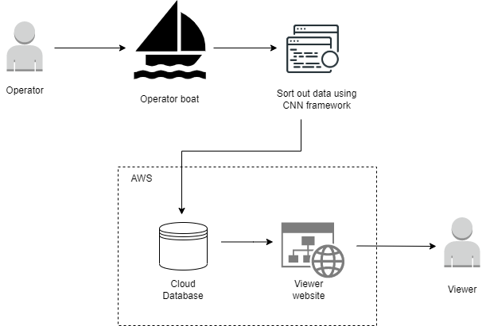
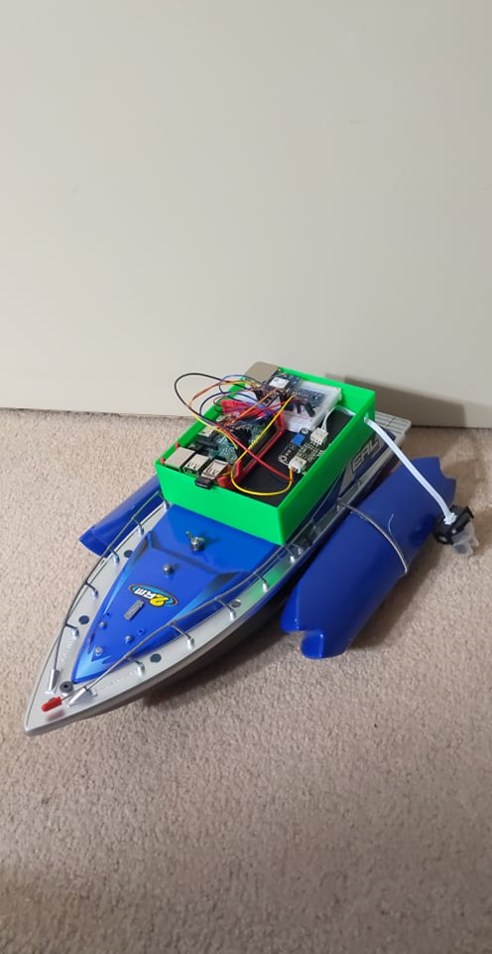
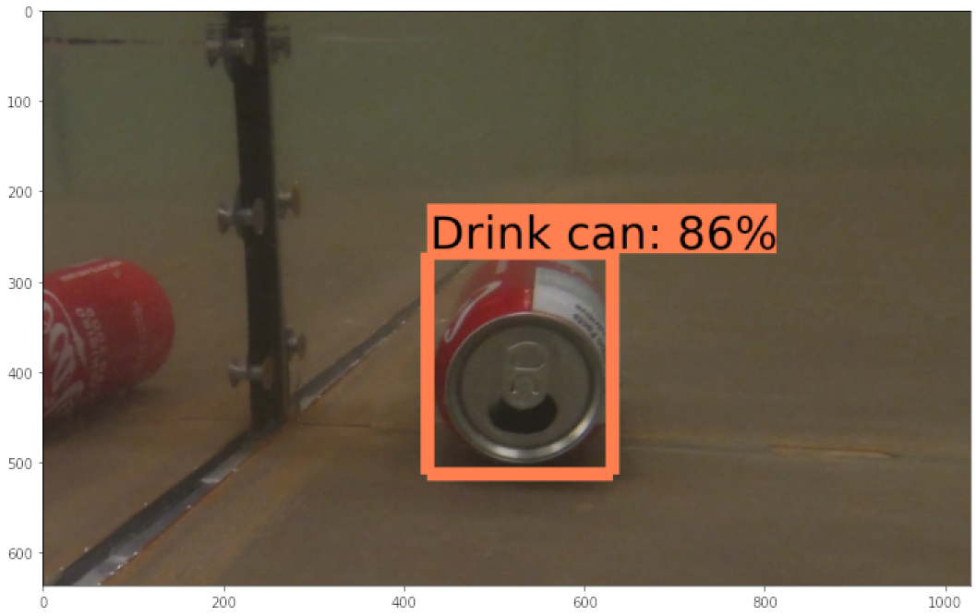
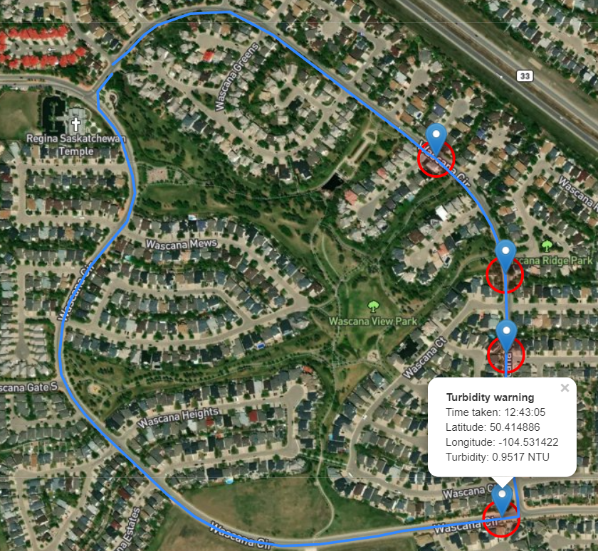

F.L.O.A.T. (Facilitating Level Objectives Assessment Technology)
An A.I. driven detection system to collect water parameters
Carter Brezinski & Jonathan Vargas
Introduction
We have developed a system that captures and logs water parameters along with any foreign objects.
Our system automates collection of data and provides a clear view on water quality on any body of water.
Methodology
Video, GPS data, and the parameter of turbidity are collected by an operator driven boat. Litter is then identified and tagged with the algorithm. All other information is tagged by time and location. This information is then stored into our database via operator upload. The logged data is then presented and shown to the viewer.
Underwater video is processed under multiple filters to identify common foreign objects against a specified dataset.
Future additions
Real-time Object Detection
Deepsort integration
Improve classification model
Heatmap integration
Resources cited
[1]Alexey Bochvosky (Oct 2021) Darknet https://tinyurl.com/43y9m838
[2] Google open images: https://tinyurl.com/4k9xca2m
[3] Saskatchewan water quality search: https://tinyurl.com/ytc75djh
[4] Guidelines for Canadian Recreational Water Quality Third Edition (Aug 2012) https://tinyurl.com/2862e4f8
Figure 2: Systems architecture
Results & Conclusions
Figure 3 displays our classification model able to detect litter underwater with a relatively high accuracy. Our model will improve with more training and by increasing the dataset of chosen objects.
In Figure 4, the map displays water parameters with its corresponding gps data. In addition to this, our web client contains the resultant video taken by the GoPro, that is then filtered through our software to detect litter. This data and video footage could be provided to the Government of Saskatchewan to be further processed.
Figure 1: Operator boat
Acknowledgements
Christine Chan
Timothy Maciag
Ben Lichtenwald
Matthew Palmarin
Dylan Rush
Motivation
Water health plays a vital role in our lives and maintaining public waters is a multi-step process
Our goal is to create proof-of-concept prototype system that that could aid in maintaining the quality of public waters in Saskatchewan.
Contact Information
Jonathan: jbv071@uregina.ca
Carter: cjb543@uregina.ca
https://github.com/
Rubber-Duck-Solutions/
F.L.O.A.T.
Materials and software used
AWS
YoloV4
Darknet
Raspberry pi
GoPro HERO7
Turbidity Sensor
GPS Sensor
Figure 3: Litter classification
Figure 4: Map readings
Notes:
https://www.youtube.com/watch?v=BlHCPf9aAXk&ab_channel=WanderingtheInternetwithNickWinchester
https://waterquality.saskatchewan.ca/PrimaryStation
Could potentially split materials used up into Materials used & Software Used
Literature cited might need some work
Dylan Rush is a graduated software engineer who has helped model and 3D print the schematics for the boat, I’d say he deserves a thanks even if this thing doesn’t get sent out into the water

